Slide 1


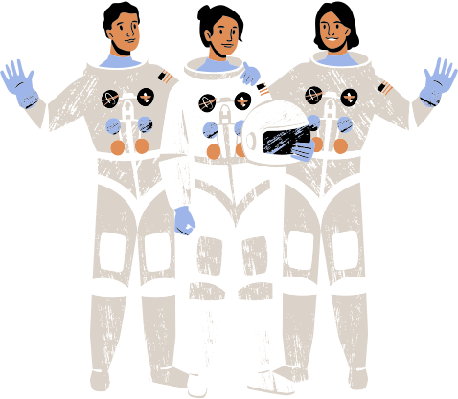

Multiple Regression & Astro Physics
Omkar Patil 21102A0003
Pranav Redij 21102A0005
Deep Salunkhe 21102A0014
Sukant Thombare 21102A0037

Slide 2



Stellar Evolution Models

Slide 3

Understanding Stellar Evolution Models:
Stellar evolution models are theoretical frameworks used to simulate the life cycles of stars from their formation to their eventual demise.
These models incorporate physical principles, such as nuclear fusion, hydrostatic equilibrium, and energy transport mechanisms, to predict how stars evolve over time.
Stellar evolution models are essential for understanding the observed properties of stars, interpreting astronomical data, and making predictions about stellar populations in galaxies.

Slide 4
Data Collection and Variables:
Observational data on stars are collected through telescopic observations, spectroscopy, and photometry, providing information on parameters such as temperature, luminosity, mass, and chemical composition.
These parameters serve as independent variables in the regression analysis, while stellar properties like radius, age, and evolutionary stage are treated as dependent variables.

Slide 5
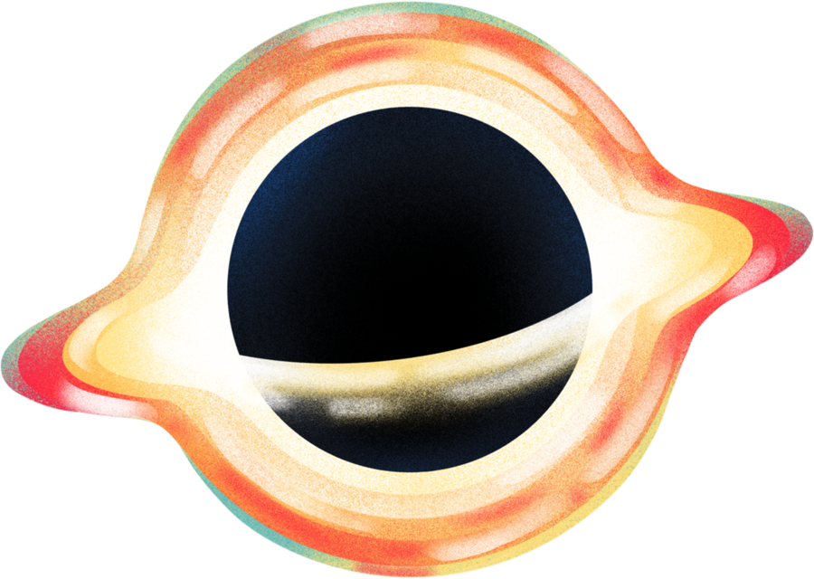
Data collection efforts may involve surveys of star clusters, galaxies, or individual stars, covering a range of stellar masses, ages, and environments.
Here's a simplified dummy equation representing the relationship between stellar luminosity (L) and two independent variables, stellar mass (M) and surface temperature (T)
L = β0 + β1 × M + β2 × T +ϵ

Slide 6
L represents the stellar luminosity, which is the dependent variable we are trying to predict.
M is the stellar mass, one of the independent variables.
T is the surface temperature of the star, another independent variable.
β0​, β1​, and β2​ are the coefficients representing the estimated effects of mass and temperature on luminosity, respectively.
ϵ represents the error term, which accounts for factors not included in the model and random variation.

Slide 7

Interpreting Regression Results:
The coefficients obtained from the regression analysis represent the estimated effects of each independent variable on the dependent variable.
Positive coefficients indicate a positive relationship, while negative coefficients indicate a negative relationship.
Statistical tests, such as t-tests or F-tests, can be used to determine the significance of the coefficients and assess the overall fit of the regression model.

Slide 8





EXOPLANET DETECTION
using multiple regression

Slide 9

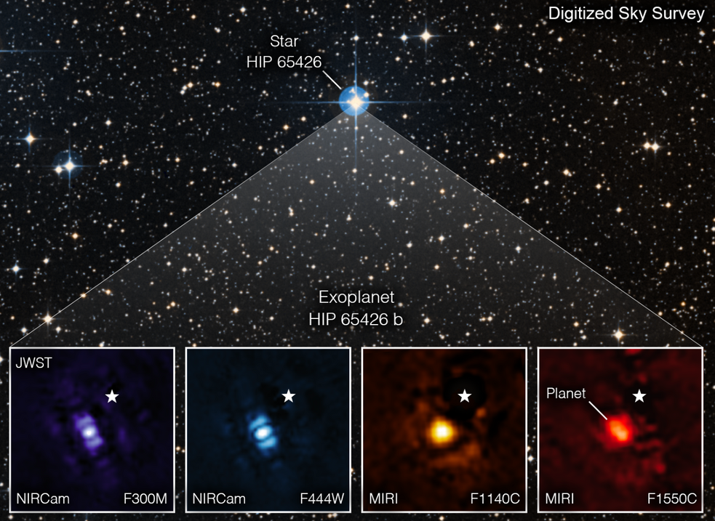
WHAT IS EXOPLANET?
An exoplanet, or extrasolar planet, is a planet located outside our solar system orbiting a star other than the Sun.
real piture of exoplanet

Slide 10


WHY WE NEED TO FIND THEM?
Understanding planetary formation and evolution.
Identifying potentially habitable worlds.
Expanding our understanding of the universe and our place in it.
Possibilities of extraterrestrial life.

Slide 11
HOW EXOPLANETS ARE NORMALLY FOUND
Radial Velocity Method (Doppler Spectroscopy)
Transit Method
Gravitational Microlensing
Direct Imaging
They are time consuming and costly

Slide 12
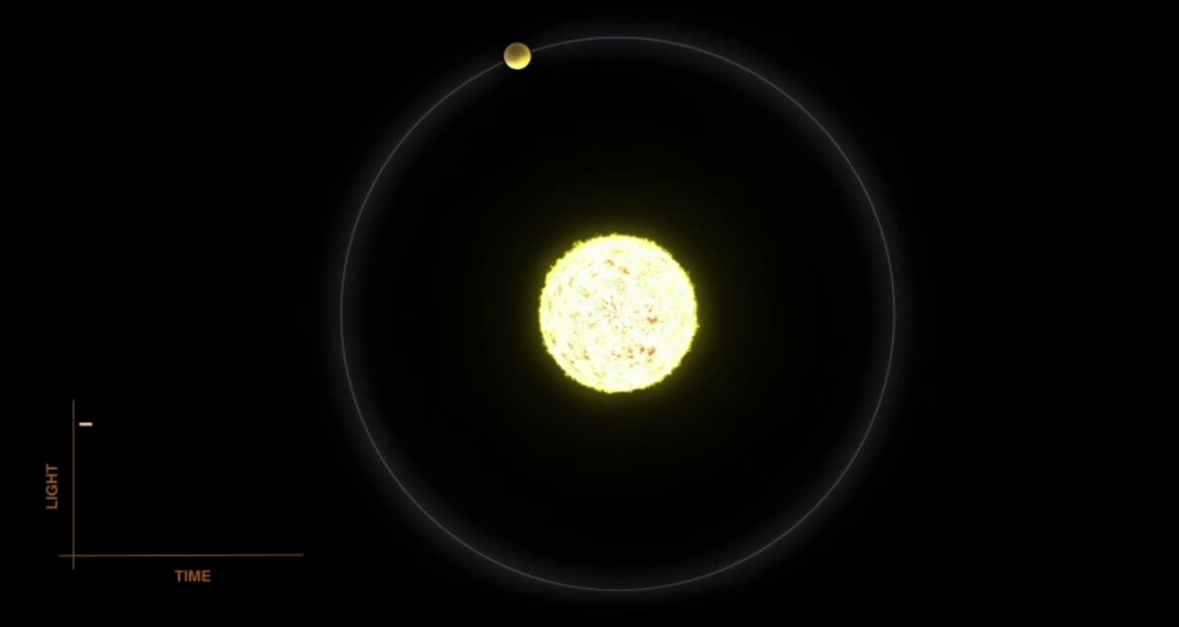
TRANSIT METHOD

Slide 13
Traditional Method’s are time consuming and costly

Slide 14
HOW TECHNOLOGY IS USED ?
Data Collection: star brightness over time, record information about the planet, like its size and orbital period.
Feature Selection: Identify factors influencing brightness dips during transits, such as planet size, transit duration, and distance from the star.
Multiple Regression Analysis: Use multiple regression to analyze how these factors collectively affect brightness dips. Create a model predicting brightness dip size based on the selected features.
Parameter Estimation: Fit the model to observed data to estimate parameter values, like the impact of planet size on brightness dip size.

Slide 15
BENEFIT’S OF CHOOSING
Cost-effectiveness
Time efficiency
Automation
Detection of rare events

Slide 16
Predicting galaxy properties

Slide 17
Predicting galaxy properties involvestatistical techniques, such as multiple regression analysis, to understand and model the relationships between various observable characteristics of galaxies and their underlying physical properties.

Slide 18
Data Collection
Astronomers collect observational data on galaxies using telescopes and other instruments across different wavelengths, such as optical, infrared, and radio. This data includes properties such as luminosity, size, morphology, spectral features, and environmental factors.
Identifying Correlations
Researchers analyze the collected data to identify correlations and patterns between different galaxy properties.

Slide 19
Hypothesis Formulation:
Based on the observed correlations, astronomers formulate hypotheses about the physical processes that govern galaxy properties.
Model Development:
Using statistical techniques like multiple regression analysis, astronomers develop predictive models that describe the relationships between various galaxy properties.

Slide 20
Model Fitting:
Astronomers fit the predictive models to observational data to determine the coefficients or parameters that best describe the relationships between galaxy properties.
Validation and Testing:
Once the model is developed, astronomers validate its accuracy and predictive power by testing it against independent datasets or by using cross-validation techniques.

Slide 21
Scenario : Predicting the properties of galaxies based on various observable characteristics.
Variables:
Dependent Variable: Total luminosity of a galaxy (measured in solar luminosities)
Independent Variables:
Stellar mass
Gas mass
Metallicity
Morphology
Redshift

Slide 22
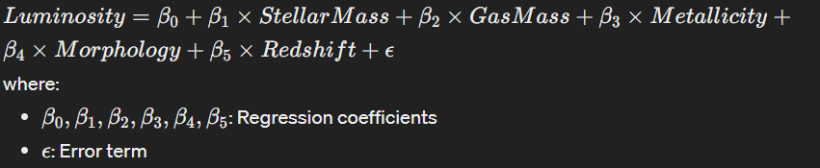
Data Collection: Gather observational data on a sample of galaxies
Data Preprocessing : Clean the data, handle missing values, and encode categorical variables.
Model Building : Use multiple regression to build a model

Slide 23
Model Evaluation: Assess the goodness of fit of the model and the significance of the regression coefficients using techniques like hypothesis testing and diagnostic plots.
Prediction : Use the model to predict the total luminosity of newly observed galaxies based on their observable characteristics.

Slide 24




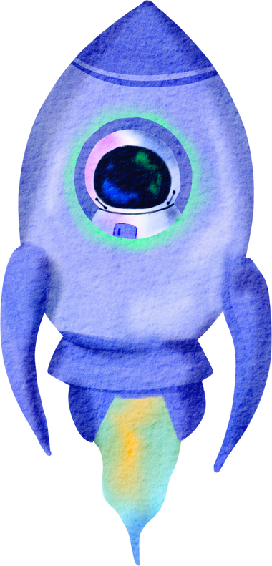

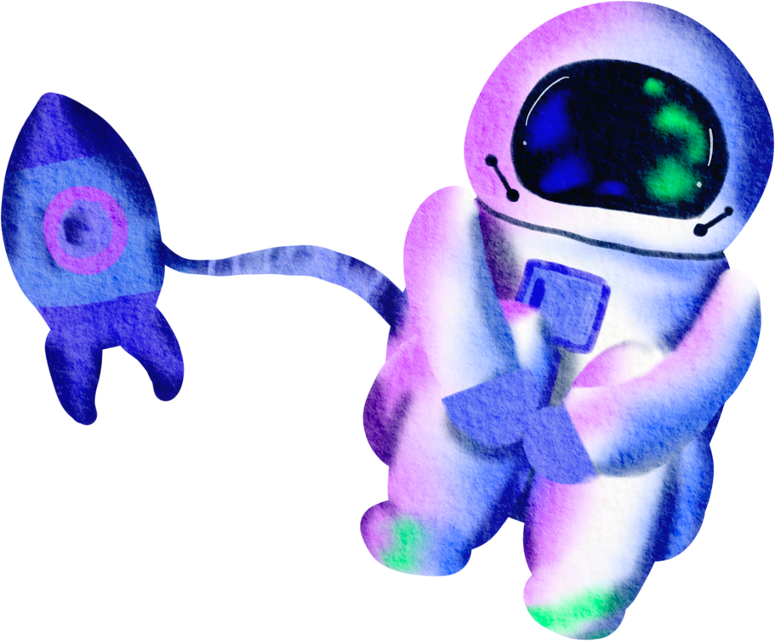

THANK YOU

